Slide 1
Using combined sequence and structural features to predict protein-ligand binding sites
Matyáš Brabec

Slide 2
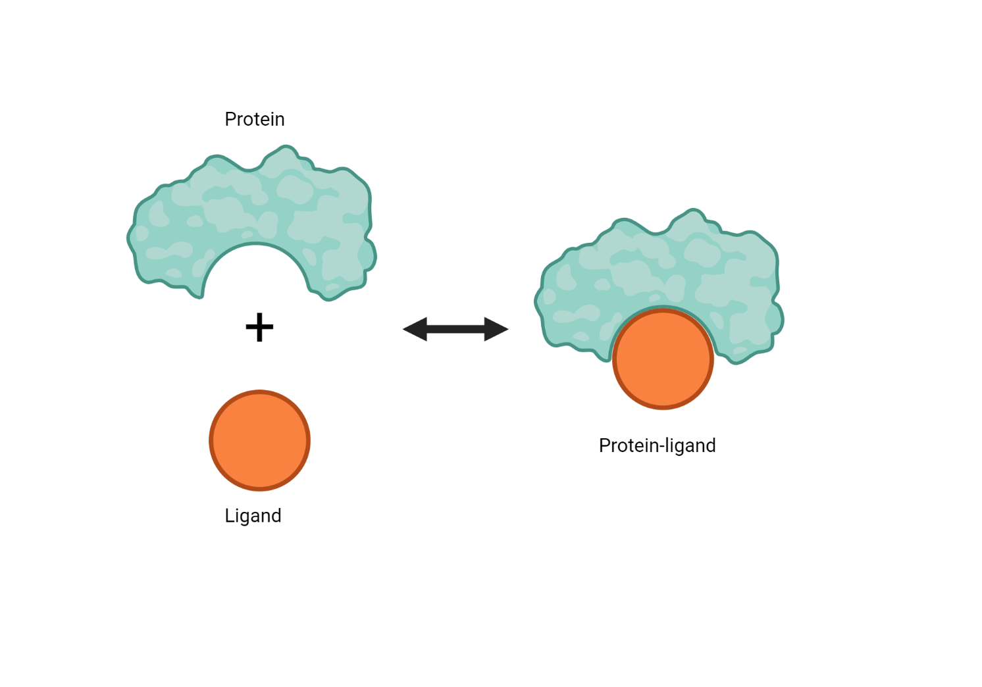
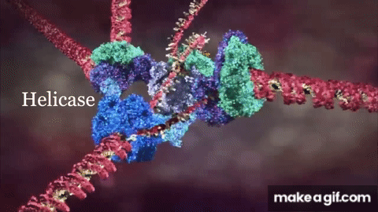
Proteins
…and Ligands
Basic building blocks of organisms
Immune system
Transportation
Cell replication
… many more
Ligands
Binds to proteins

Slide 3
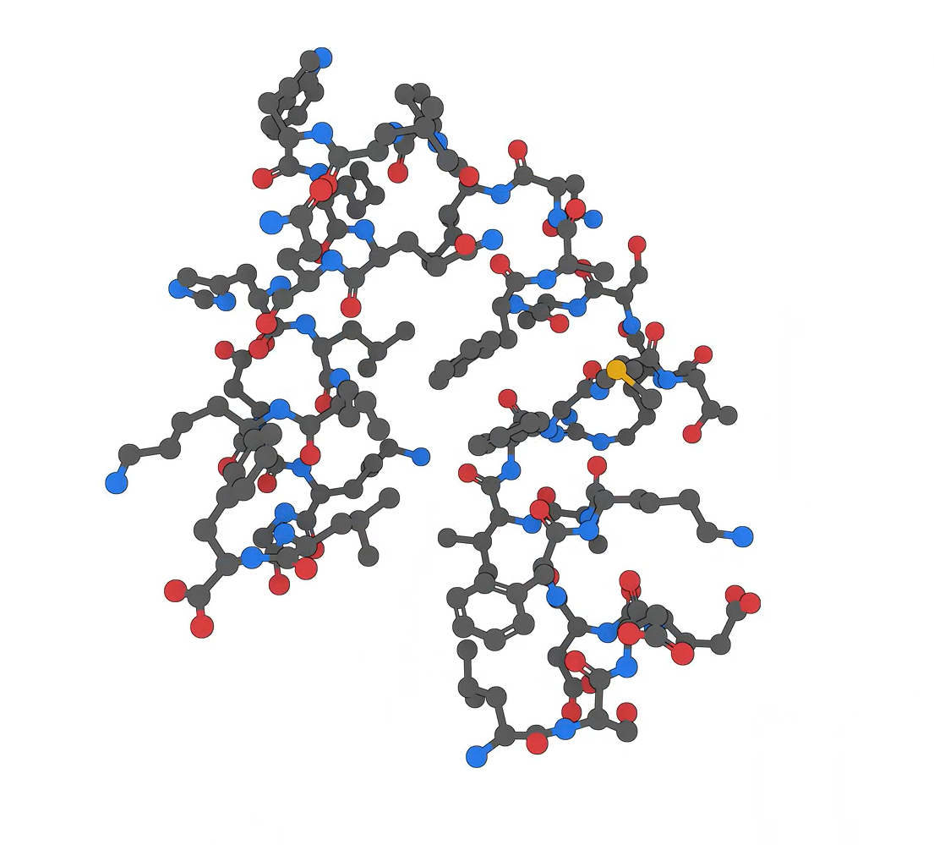
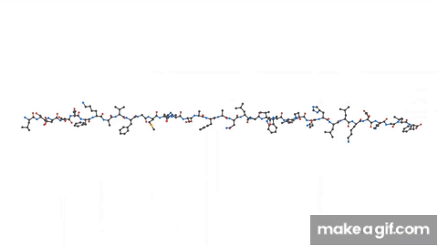
What is a Protein ?
…Molecule
…Composed of amino acids

Slide 4
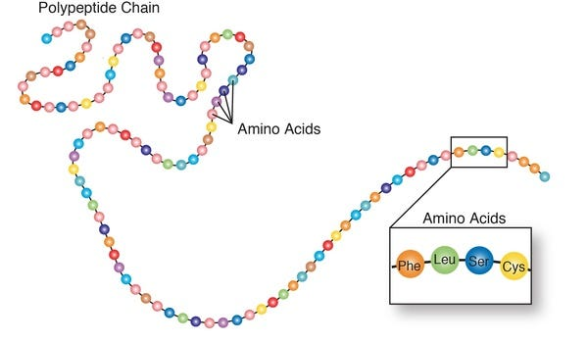
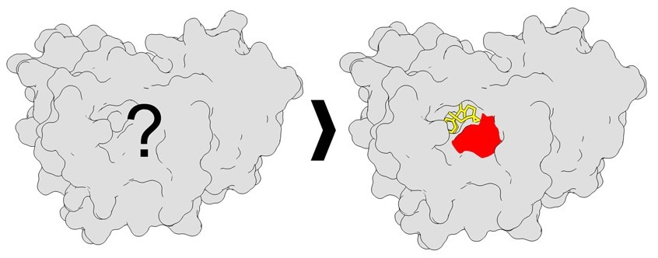
Thesis Topic
Sequence
Model
3D structure

Slide 5
What to do with Sequence ?
Protein language models
Protein ~ Sentence
Amino Acid Residues ~ Words

Slide 6
What to do with Sequence ?
Protein language models
Sequence of amino acid residues
Sequence of vectors (embeddings)

Slide 7
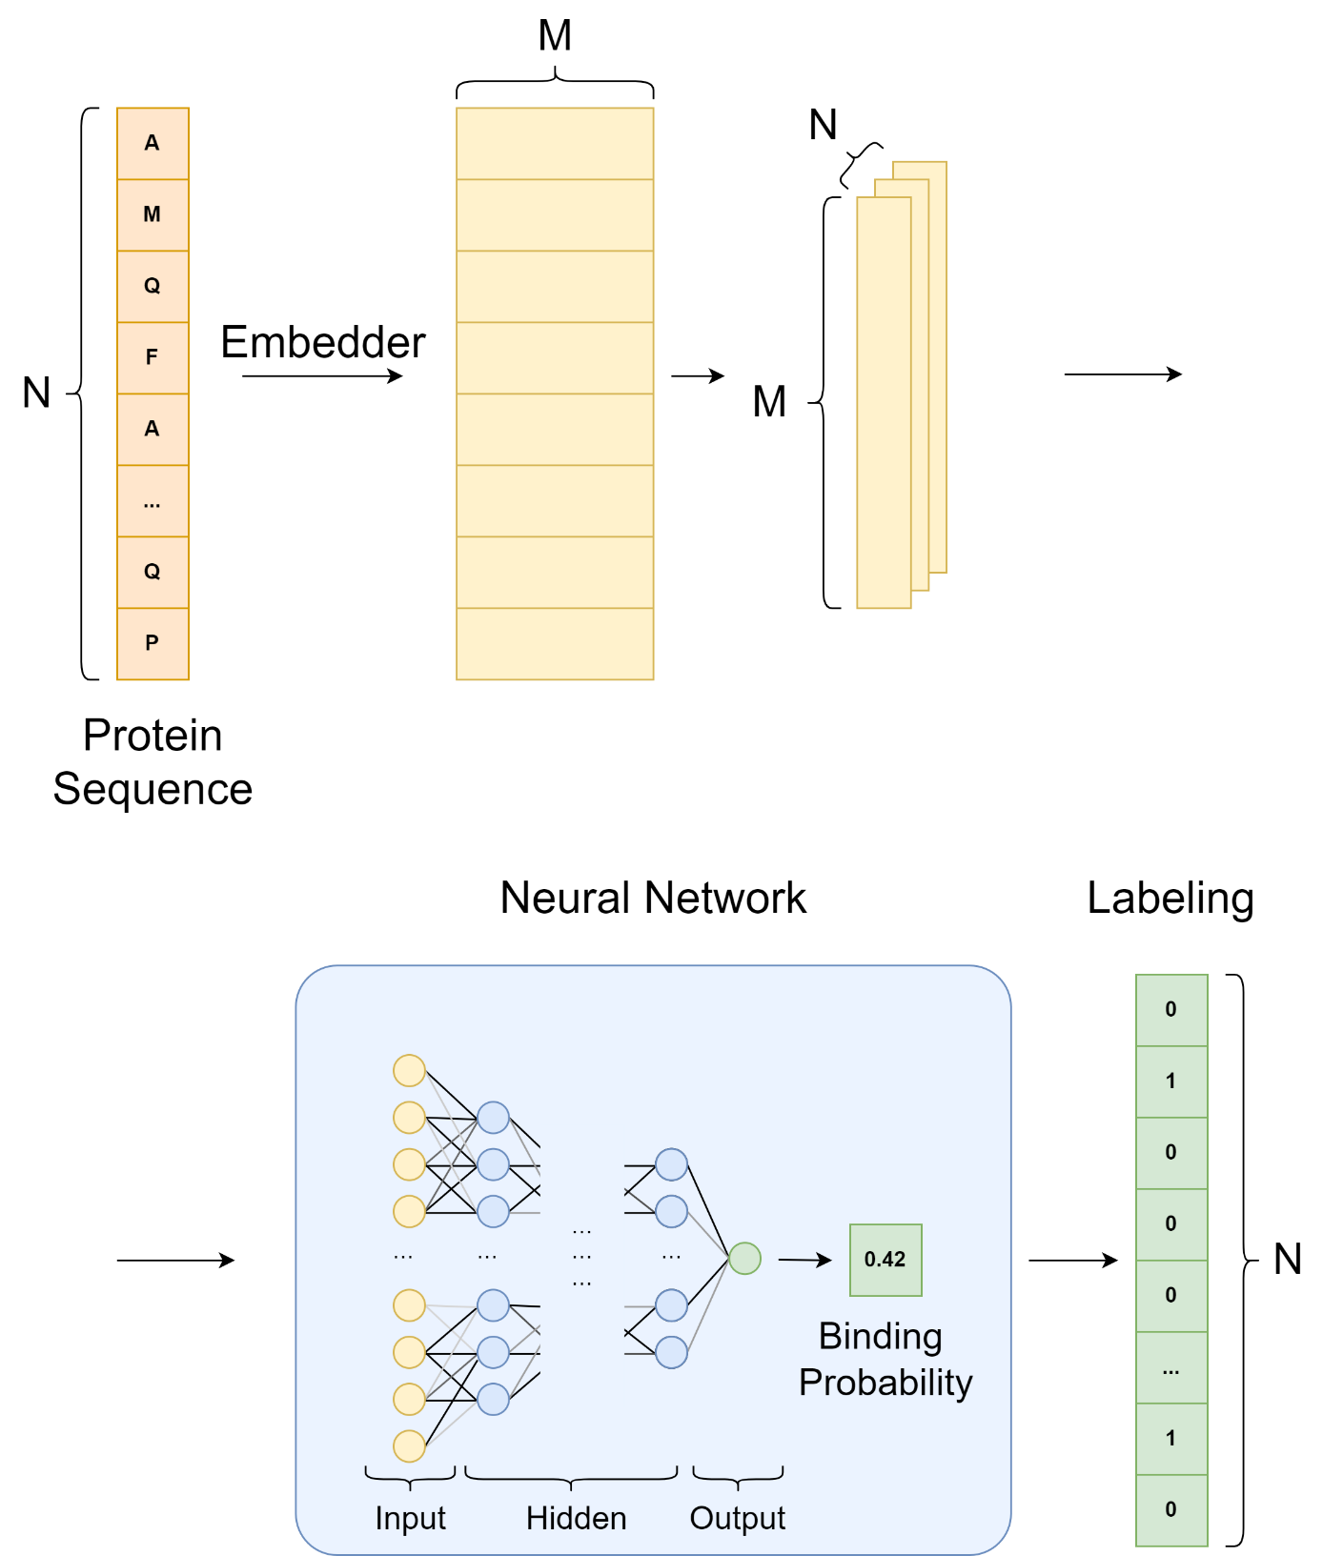
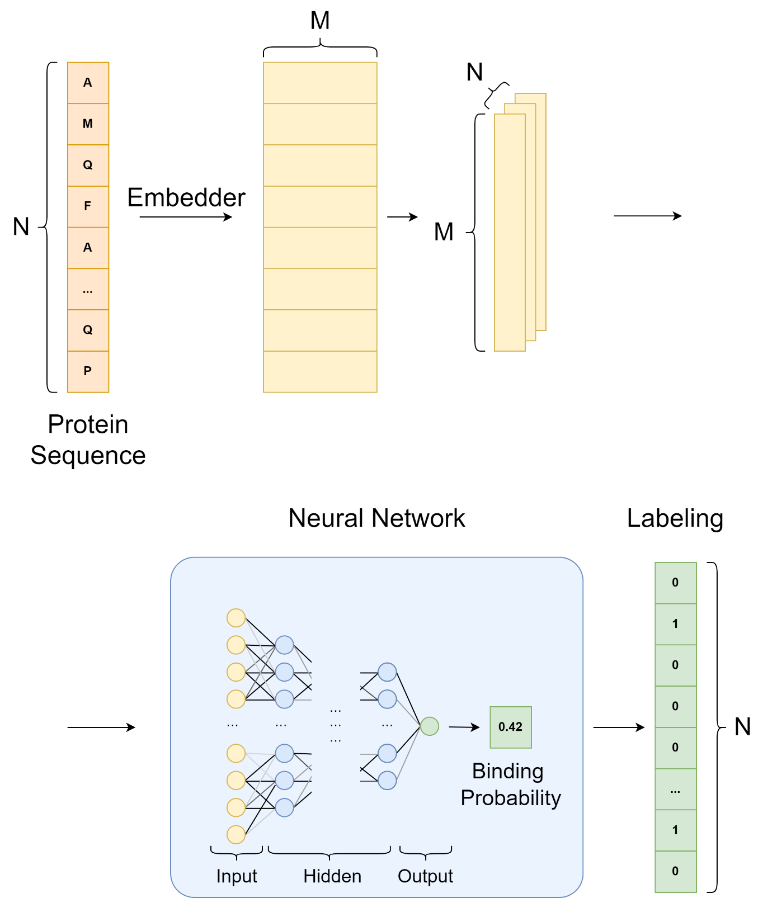
Baseline Model

Slide 8
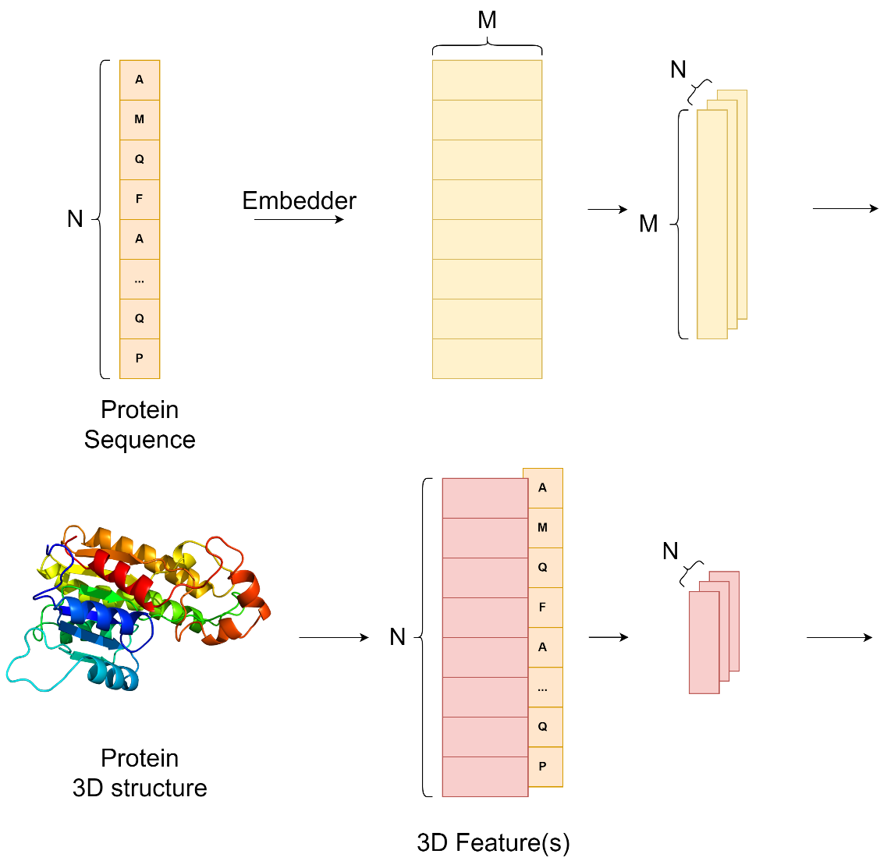
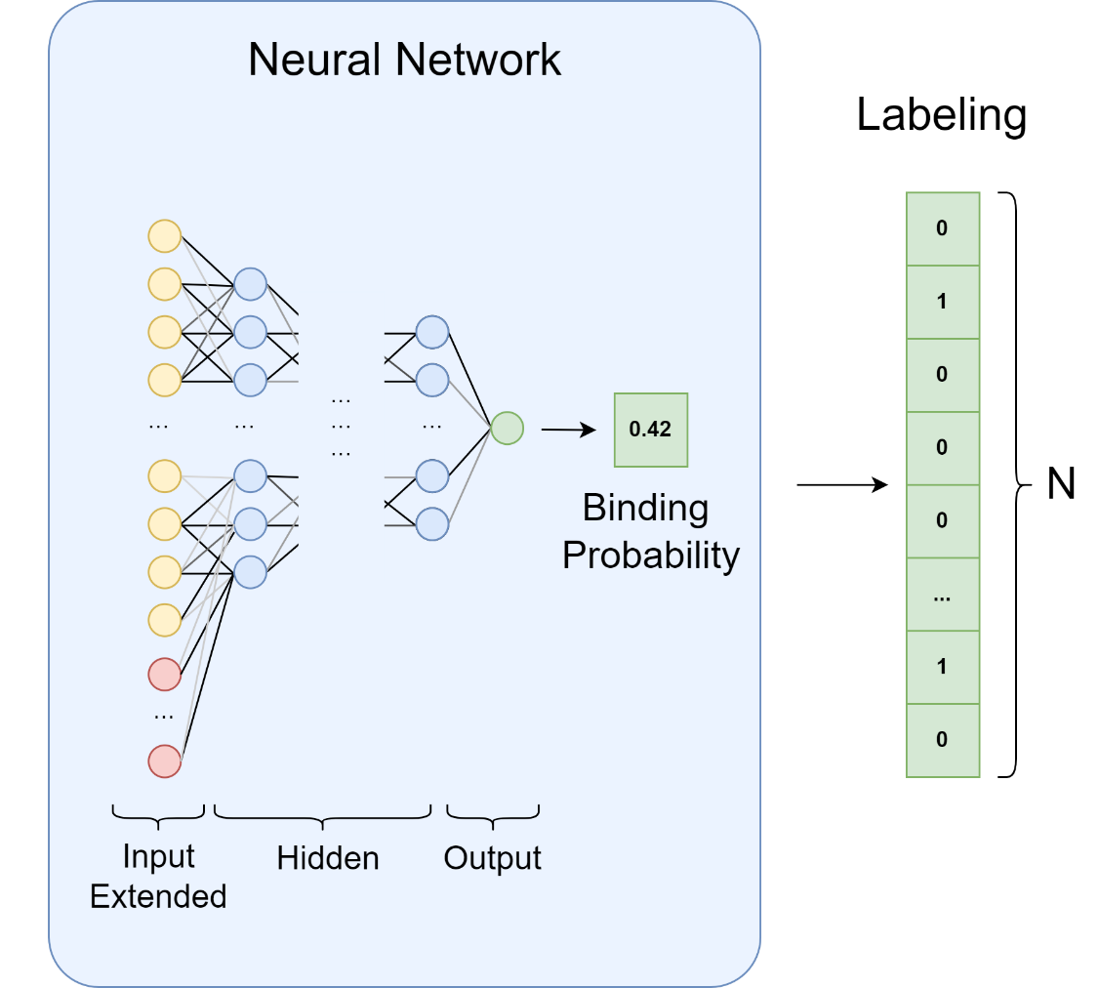
3D Features Models

Slide 9
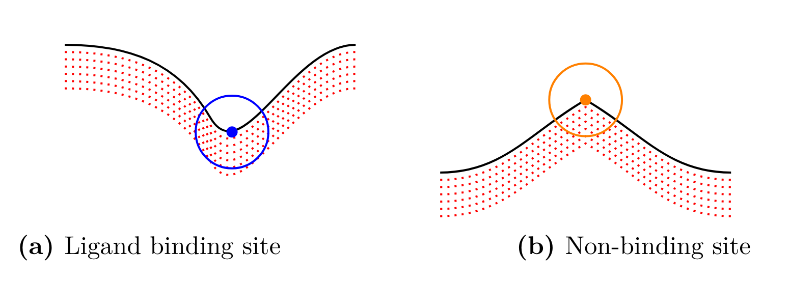
Protrusion

Slide 10
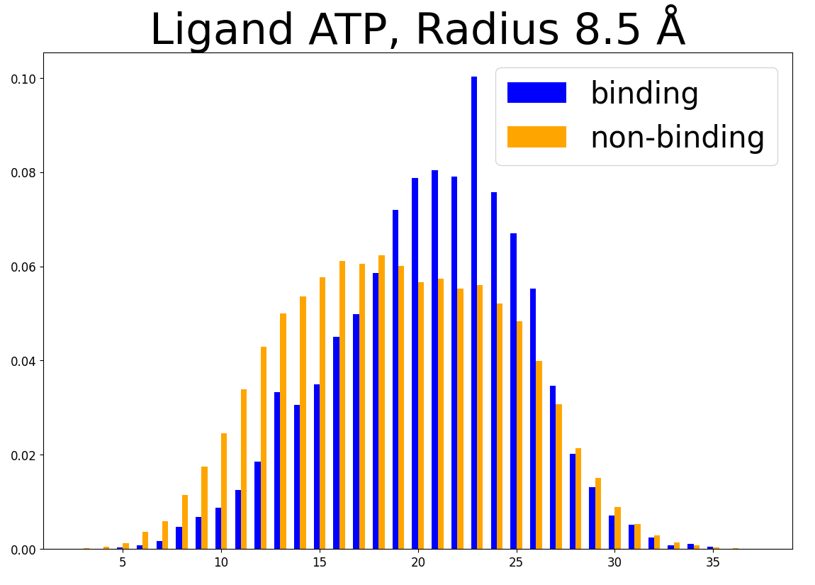
Protrusion

Slide 11
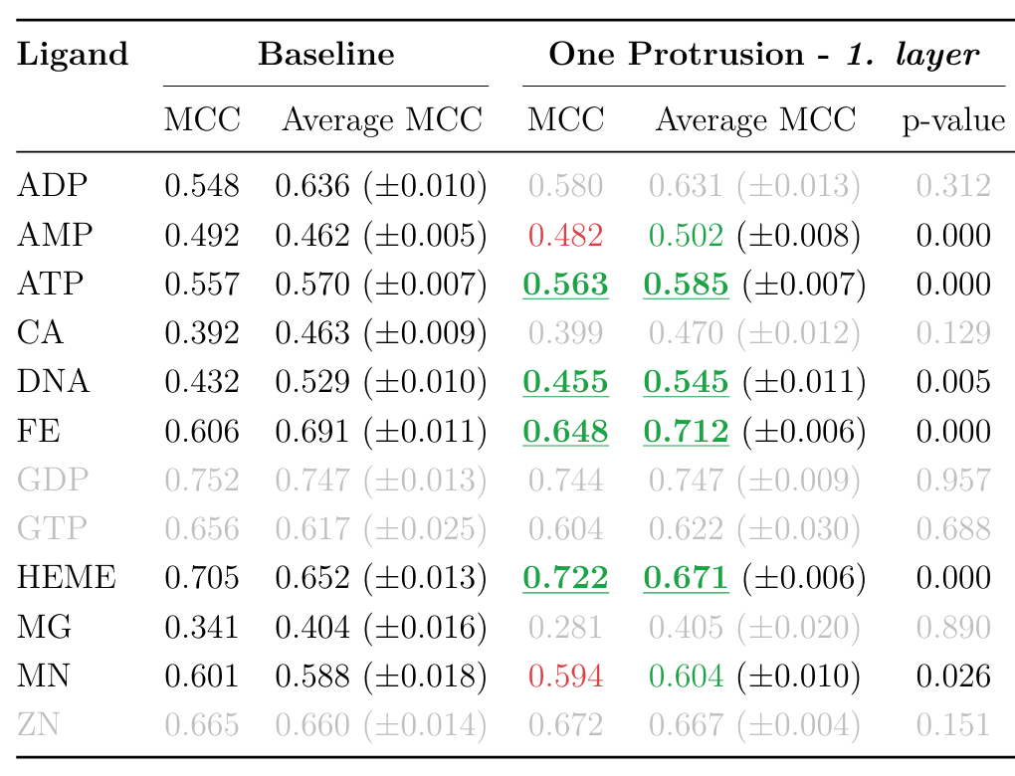
Protrusion

Slide 12
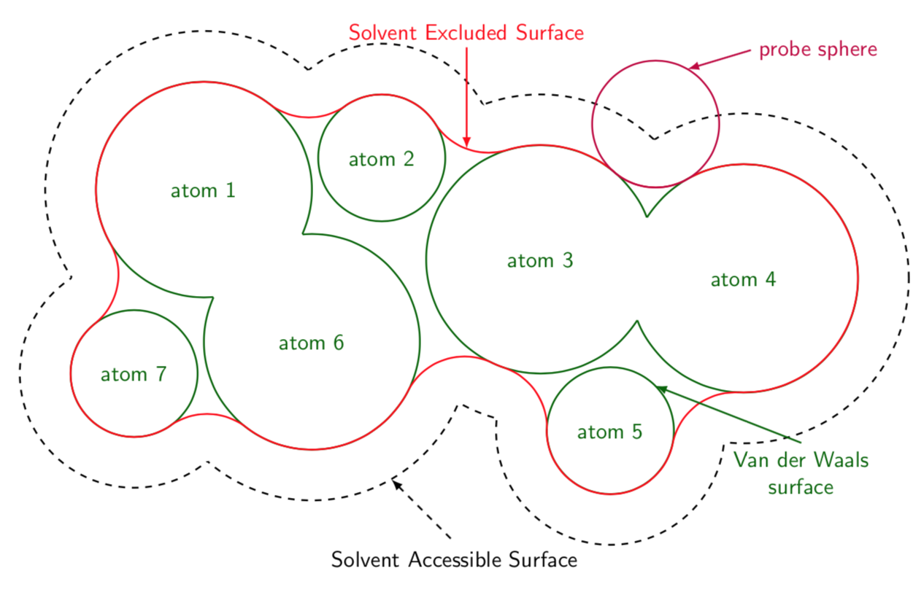
solvent accessible surface area (SASA)

Slide 13
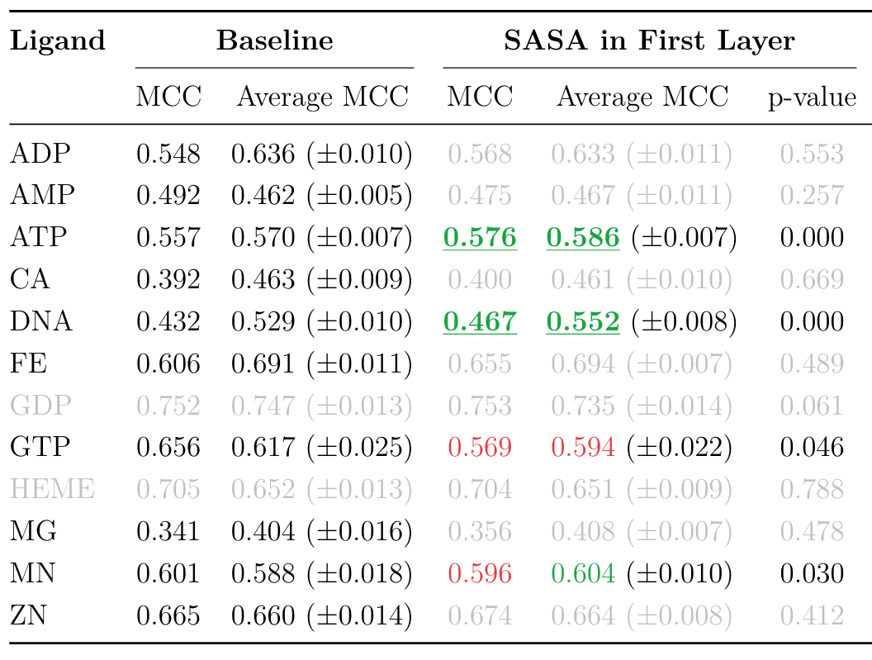
solvent accessible surface area (SASA)

Slide 14
neighboring Residues

Slide 15

neighboring Residues
Binding / Not binding

Slide 16
neighboring Residues
Binding / Not binding

Slide 17
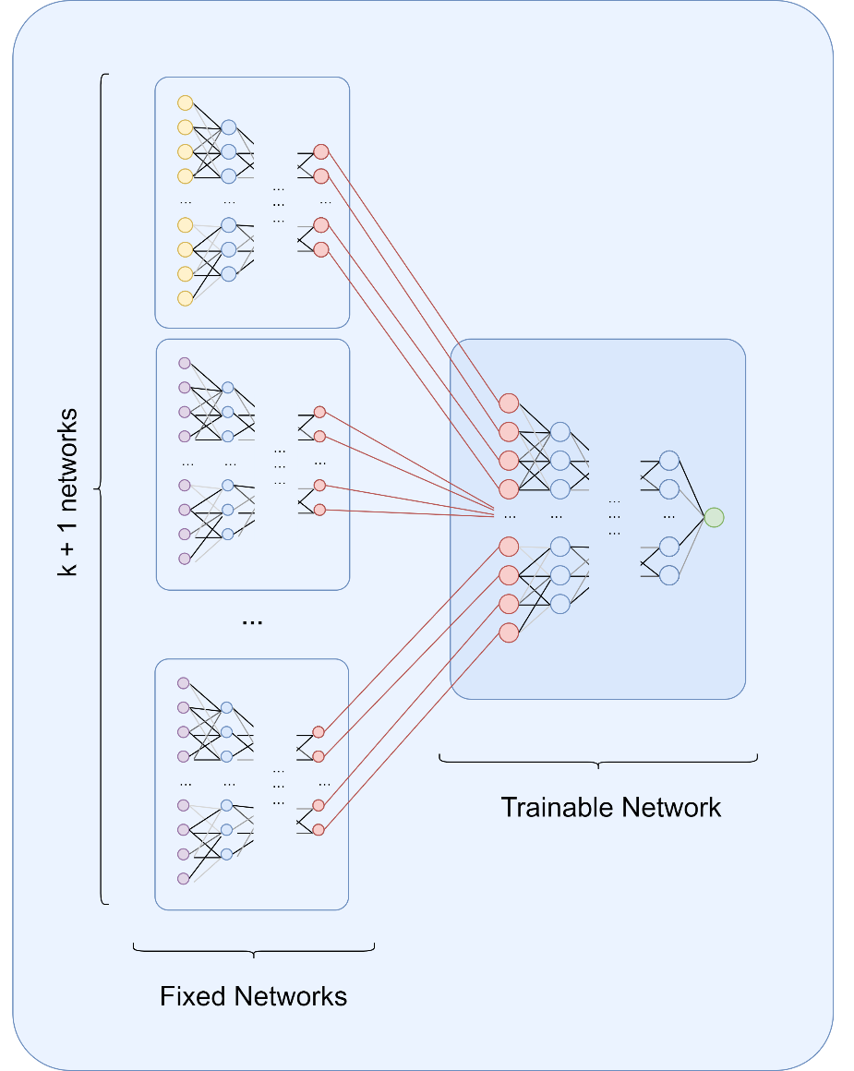
neighboring Residues
Binding / Not binding

Slide 18
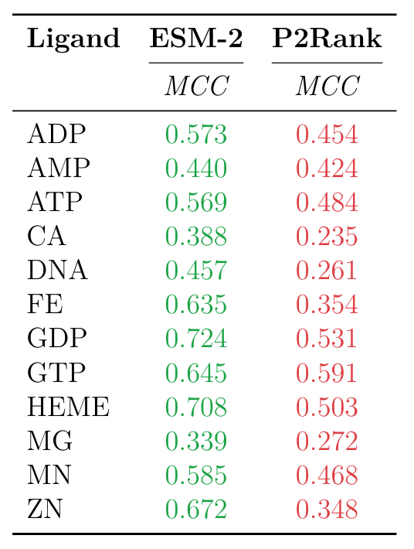
P2Rank comparison

Slide 19
Conclusion

Slide 20
Notes
Q&A

Slide 21
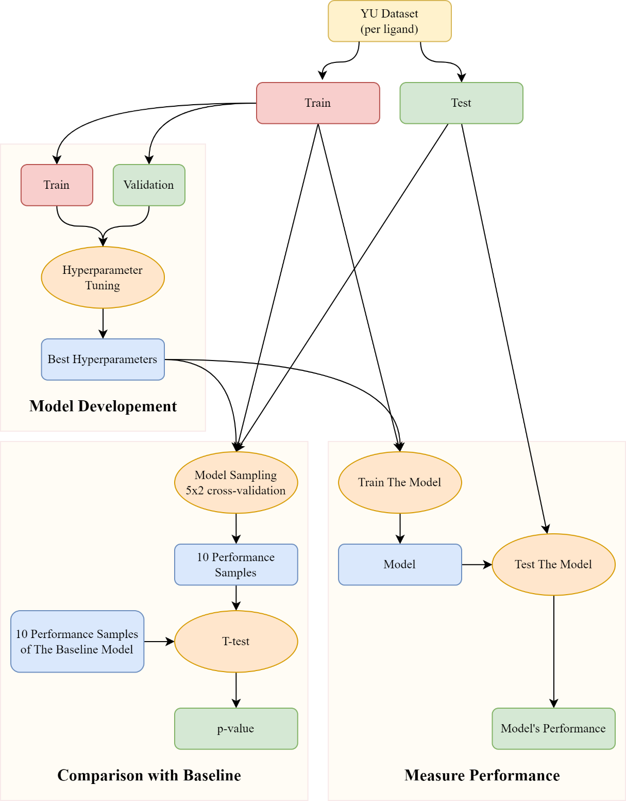

Slide 22
